Slide 1
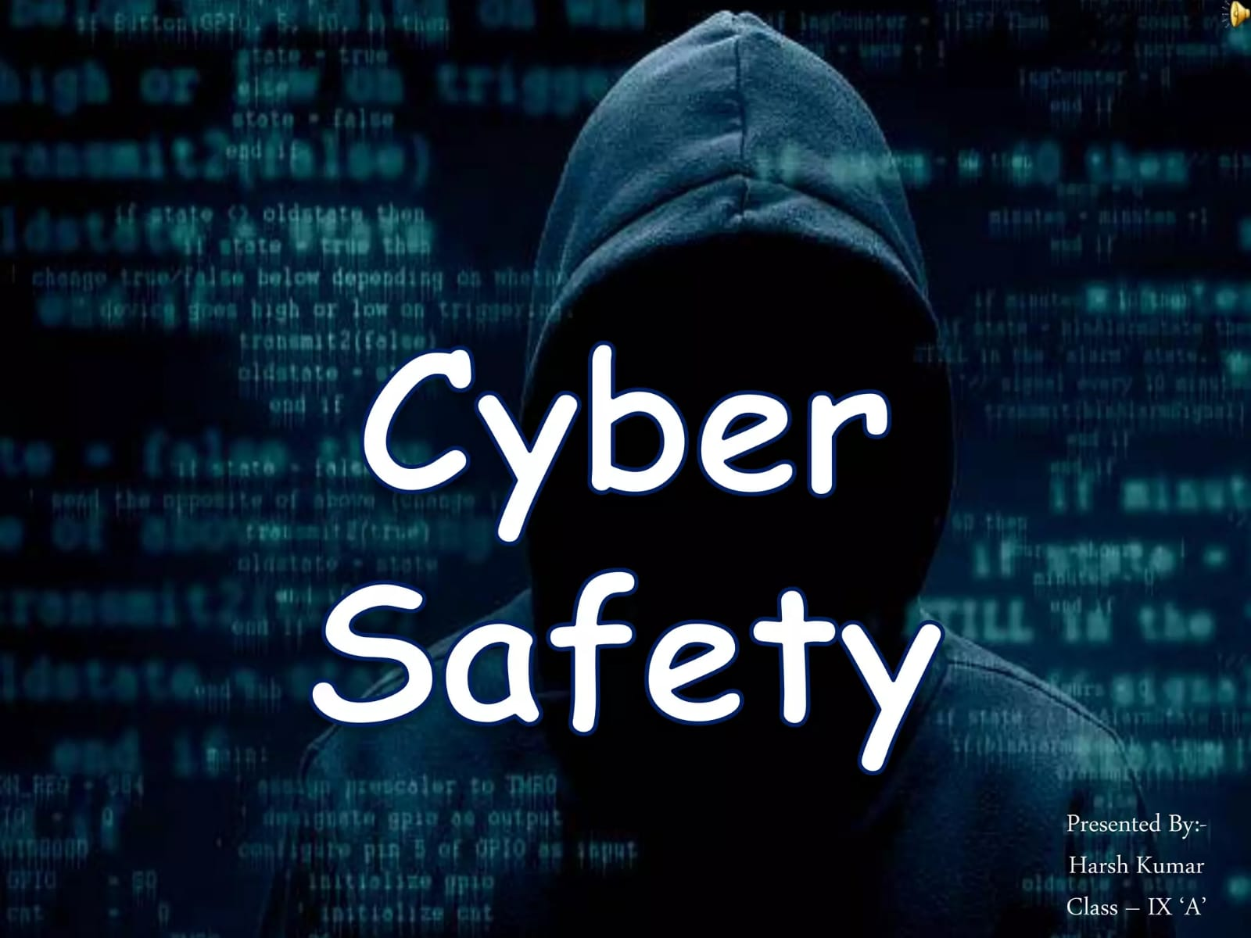

CYBER SAFETY
FOR STUDENTS
Stay smart • Stay private • Stay safe
Name-Princy Yadav
Trade-AIPA
Institute-NSTI(W)
Date- 29/09/2026
1
Notes:
Speaker Notes: Welcome everyone. This presentation explains practical cyber-safety habits students can use every day while studying, communicating and browsing online.

Slide 2

1. Introduction
Why cyber safety matters for students?
What is cyber safety?
Using devices, accounts and the internet in ways that protect your information, privacy and digital identity.
Protect
Think
Personal data, passwords and accounts
Check before clicking, sharing or downloading
Remember
Online actions can affect your privacy, reputation and security.
2

Slide 3
2. Common Cyber Threats
Recognize common warning signs :
Phishing
Malware
Fake messages or websites designed to steal information
Harmful software such as viruses or spyware
Account hacking
Cyberbullying
Unauthorized access using stolen or guessed credentials
Harassment, threats or humiliation through digital platforms
3

Slide 4
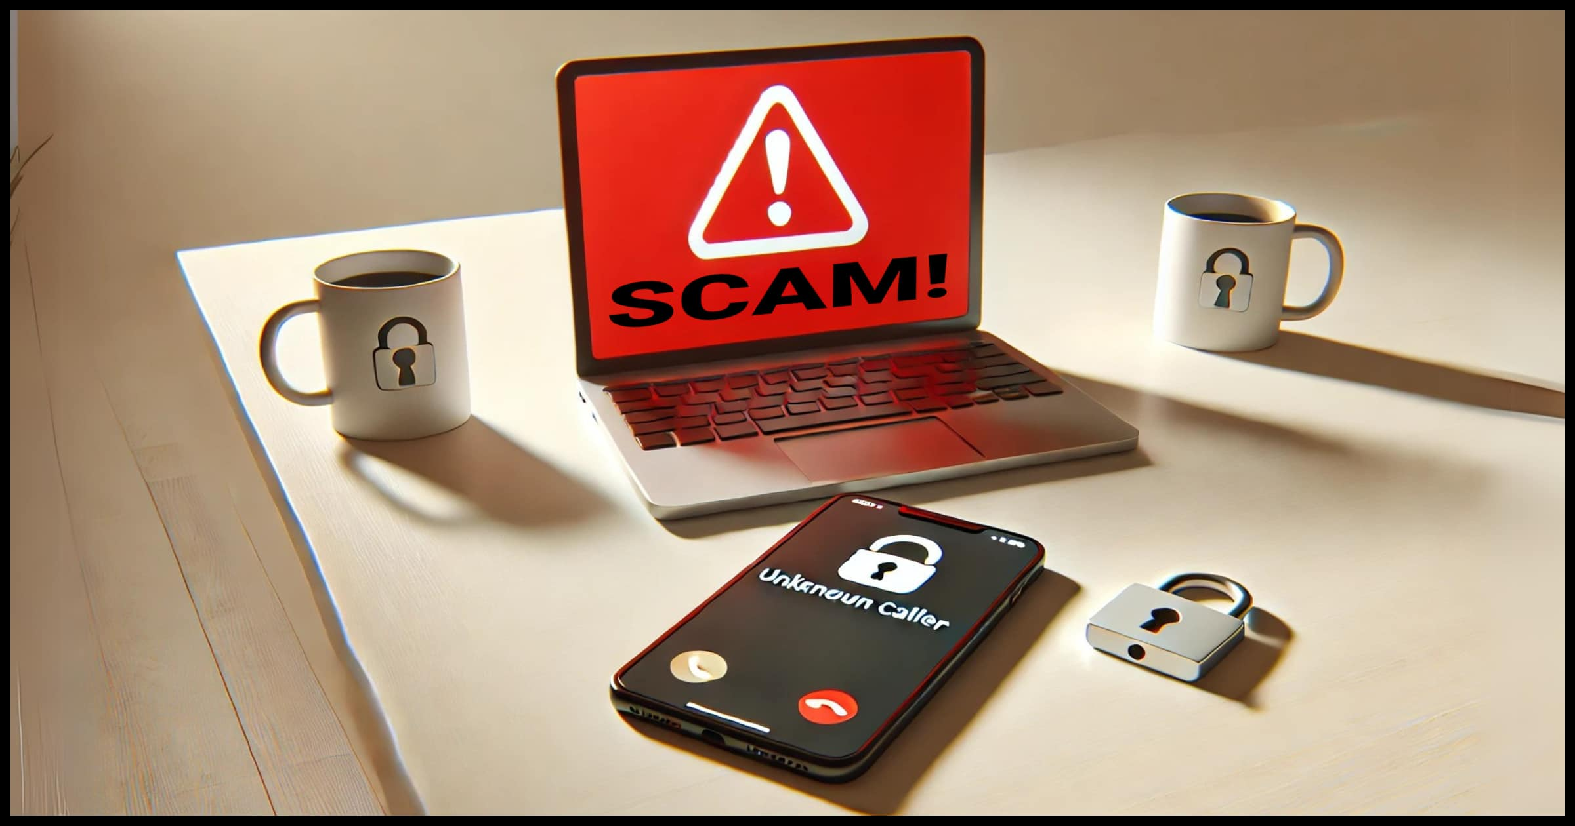
3. Phishing & Online Scams
Pause before you click
• Urgent messages: “Act now” or “Your account will be closed.”
• Unexpected links, attachments or login requests.
• Requests for OTPs, passwords, PINs or personal information.
• Misspelled domains or suspicious sender addresses.
• Verify through the official app or website instead of the message link.
This Photo by Unknown Author is licensed under CC BY-NC-ND
Notes:
Speaker Notes: Emphasize that urgency is a common social-engineering technique. Students should verify requests independently and never share passwords or one-time passwords.

Slide 5
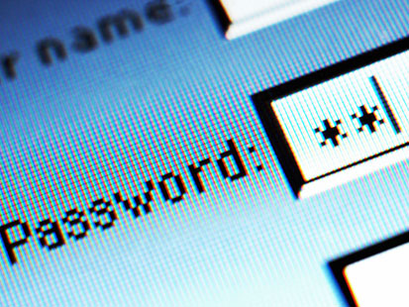
4. Password Security
Make account takeover harder
Use strong, unique passwords
Avoid names, birthdays and predictable patterns. Do not reuse the same password across important accounts.
Longer is stronger
Enable MFA
Use a memorable passphrase or a long password.
Use multi-factor authentication where available.
Never share credentials
Keep passwords, PINs and verification codes private—even if a message claims to be from support.
5

Slide 6
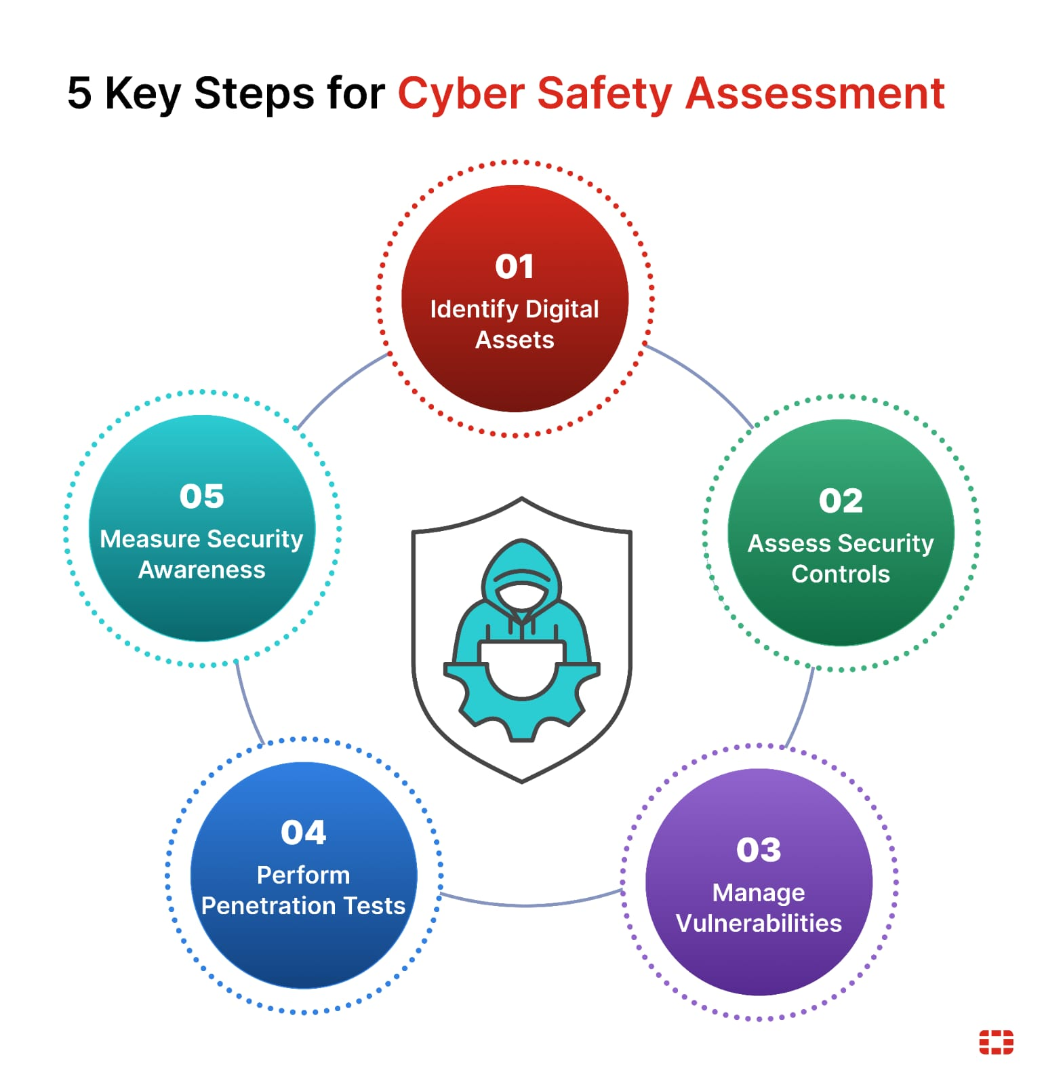
5. Social Media Safety
Control what you share
• Review privacy settings and who can see your posts.
• Think before posting personal details, live location or school information.
• Accept requests only from people you know or can verify.
• Block and report abusive or suspicious accounts.
• Remember: screenshots and reposts can make information hard to take back.
6

Slide 7
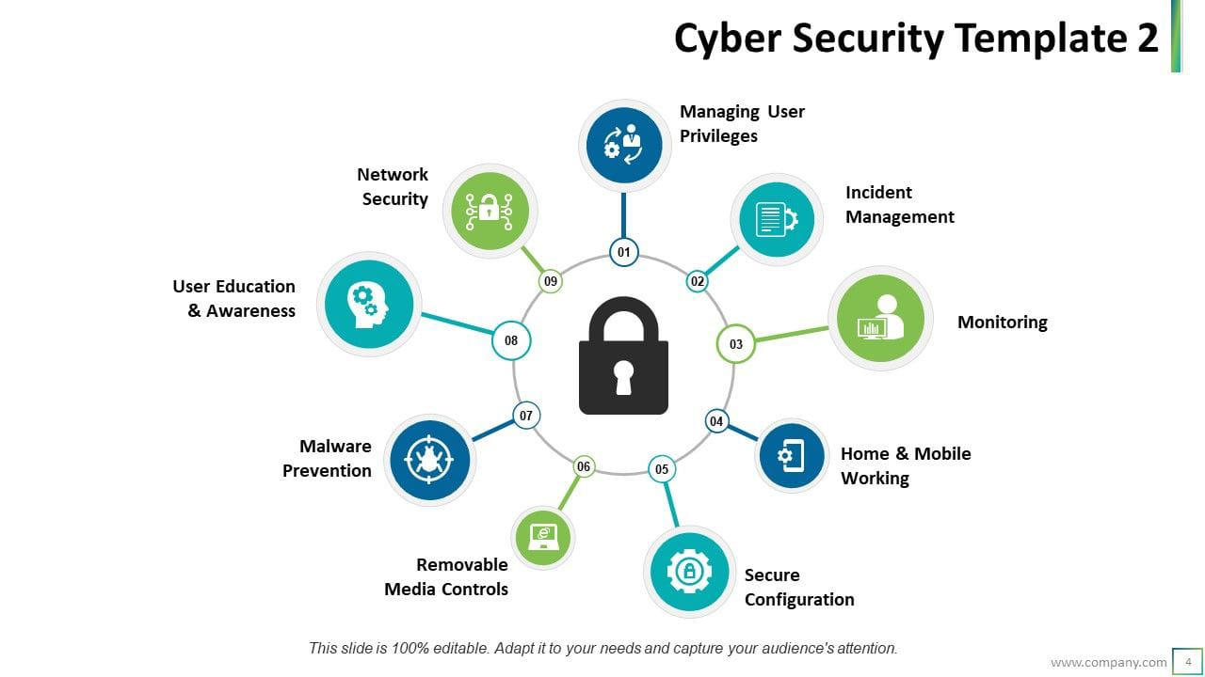
6. Safe Internet Browsing
Use a simple check before downloading or logging in
Check | Safer choice | Warning sign
Website | Type the official address yourself | Strange domain or misspelling
Download | Use trusted sources | Unknown file or cracked software
Connection | Prefer secure, trusted networks | Open public Wi‑Fi for sensitive tasks
Pop-ups | Close suspicious alerts | Fake virus warnings or prize claims
7

Slide 8
7. Real-Life Scenario
A student receives a “scholarship” message:
1. Message
“Congratulations! Claim your scholarship now.”
2. Link
Student is asked to log in and enter OTP.
3. Pause
Student checks the sender and official scholarship site.
4. Safe action
Student avoids the link and verifies independently.
Lesson
Urgency + unfamiliar link + request for credentials = stop, verify and use an official channel.
8
Notes:
Speaker Notes: Ask students what they would do at each step. The key habit is to stop and verify through an independent, trusted channel rather than using the link in the message.

Slide 9
8. Safety Checklist
A five-step protection routine:
STOP
CHECK
PROTECT
THINK
REPORT
Don't rush
Sender + link
Password + MFA
Before sharing
Suspicious activity
• Keep devices and apps updated.
• Back up important school files.
• Log out on shared computers.
• Tell a trusted adult/teacher or platform when something feels unsafe.
9

Slide 10

9. Conclusion
• Think before you click, share or download.
• Protect passwords and use multi-factor authentication.
• Keep social media and personal information private.
• Verify suspicious messages through official channels.
• Speak up and report cyberbullying, scams or suspicious activity.
Final message
Be curious online—but be careful.
10
Notes:
Speaker Notes: Recap the five core habits: stop, check, protect, think and report. Invite students to choose one habit they will start using today.

